Slide 1
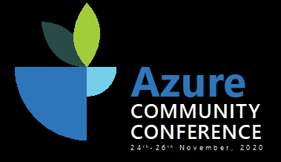

Build great solution with
Microsoft Well Architected Framework (WAF)
Maheshkumar R
Partner Tech Strategist, Microsoft India
MahesKBlr
Notes:
Hello and thank you all very much for taking the time to join today.
Personal Intro

Slide 2

Agenda
● Why is being well-architected important?
● Overview: Microsoft Azure Well-Architected Framework
● WAF Pillars, Demo, tools, reports and Assessment tracker
● Overcoming workload quality inhibitors
● Resources & Amplification

Slide 3
Why is being well-architected important?
Notes:
Let’s begin by discussing why being well-architected is more critical than ever.
Are you well-architected? Do you know how far? Yes, but when we deep dive into those 5 areas often the answer is not quite the same.
Opportunities to improve, process to review and address the gap.
Why WAF ?
Build and deploy faster, Lower or mitigate risks, Make informed decisions, Learn Azure best practices

Slide 4
Well-architected solutions enable—
cost optimization
It’s more critical than ever for customers to get a handle on forecasting and cost optimization¹
Customers reported their public cloud spend was over budget by an average of 23 percent¹
Respondents expect their cloud spend to further increase by 47 percent in the next 12 months.
Organizational spend on public cloud
Average % across all respondents
Current Spend
Growth in next 12 months
Next 12 months
47%
Original Budget
Amount over budget
Current cloud spend
23%
N=750
¹ Flexera 2020 State of the Cloud Report

Slide 5

Well-architected solutions enable— cost savings in security spend
In 2019, encryption, business continuity management, DevSecOps, and threat intelligence sharing mitigated cost¹
Encryption reduced breach costs by an average of $360,000.
Business continuity management reduced the total cost of a data breach by an average of $280,000.
¹ The Cost of a Data Breach Report, IBM Security, 2019. Conducted by Ponemon Institute LLC

Slide 6
Well-architected solutions enable— cost savings with resiliency, high-availability, and security automation strategies
Companies with incident response teams with testing of IR plans —saved over $1.2 million¹.
Organizations without security automation experienced breach costs 95 percent higher
Breach costs rose above 16 percent at organizations without automation deployed, going up from an average of $4.43 million in 2018 to $5.16 million in 2019.
Breach costs decreased by 8 percent at organizations with fully deployed automation, from 2018 to 2019, from an average of $2.88 million in 2018 to $2.65 million in 2019.
¹ The Cost of a Data Breach Report, IBM Security, 2019. Conducted by Ponemon Institute LLC

Slide 7
Overview: Azure Well-Architected Framework
Notes:
WAF: Set of best practice guidance that speaks to a couple of roles in every organization specifically solution architects, engineering managers and lead engineers.
How do I architect for cloud?
Are you carrying or constrained by on-premises assumptions? So many resources, where to start?
How do i know if I have done something wrong?
Am I ready to go into production?
Are my teams following best practices?

Slide 8



Well-architect & optimize workloads for success
Build workloads with confidence using proven best practices | Actionable & simple-to-use deep technical resources to design workloads that show results | Know where to focus to optimize workloads

Slide 9
Microsoft Azure Well-Architected Framework
Architecture guidance and best practices, created for architects, developers and solution owners, to improve the quality of their workloads, based on 5 aligned and connected pillars
Cost Optimization | Operational Excellence | Performance Efficiency | Reliability | Security
https://aka.ms/architecture/framework

Slide 10
Cost Optimization
Increase cost awareness
Budgets
Alerts
Tagging
Take advantage of offers
Azure Hybrid Benefit (AHB)
Reserve Instances (RI)
Leverage Spot instances for low-priority workloads
Eliminate cloud waste
Shutdown unused resources
Right sizing underutilized resources
Autoscaling and auto shutdown
Modernize architecture
Move to managed service
Automation
Notes:
Your organization has moved a majority of its systems to the cloud, but you're now seeing cost increases in areas you didn't expect. After some observation, you realize that you're inefficient across your environment, and you're still doing manual operational work.
In this unit, you'll learn about cost optimization. You'll also look at ways to reduce unnecessary expenses and improve operational efficiencies.
What are the indirect benefits?
=======================================
Efficient cloud operations improve operations costs and increase innovation.
Automate operational lifecycle to minimize errors
Move to PaaS where possible to transfer more of the stack responsibility to Azure
=======================================
Be proactive than reactive after some inefficiency

Slide 11
Cost Optimization - Demo
Notes:
Azure Pricing Calculator -> Estimate costs
Azure Cost management -> Azure portal
Azure Advisor -> Cost -> quick fix -> IP
Performance -> AKS recommended version
Advisor score –> reliability score index
Advisor REST API
Azure CM – PBI report -> aka.ms/costmgmt/acmapp
Azure compute Decision tree
Azure policy
Azure VM pricing across regions? https://azureprice.net/Region

Slide 12
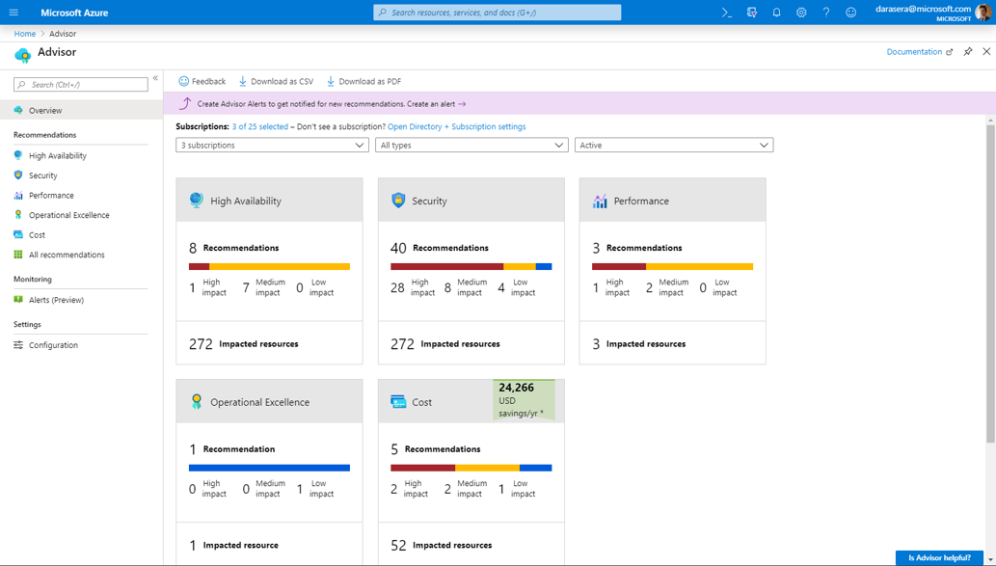
Azure Advisor
Get cost recommendations based on your usage and configurations, such as:
Shut down unused VMs
Right size underused VMs
Buy Reserved Instances for consistent resources
Delete idle network gateways
Remediate recommendations easily with step-by-step guidance
Review your Advisor recommendations in the Azure portal: aka.ms/azureadvisor
Notes:
what risks are in each?
where should I invest?
where is my inventory of workloads?
How are risks changing over time?
can I build mechanisms?
May be you need training? patterns and practices? repeatable process
---
General guide lines:
Stop guessing your capacity needs?
Test systems at production scale?
Automate to make architectural experimentation easier?
Drive architectures

Slide 13

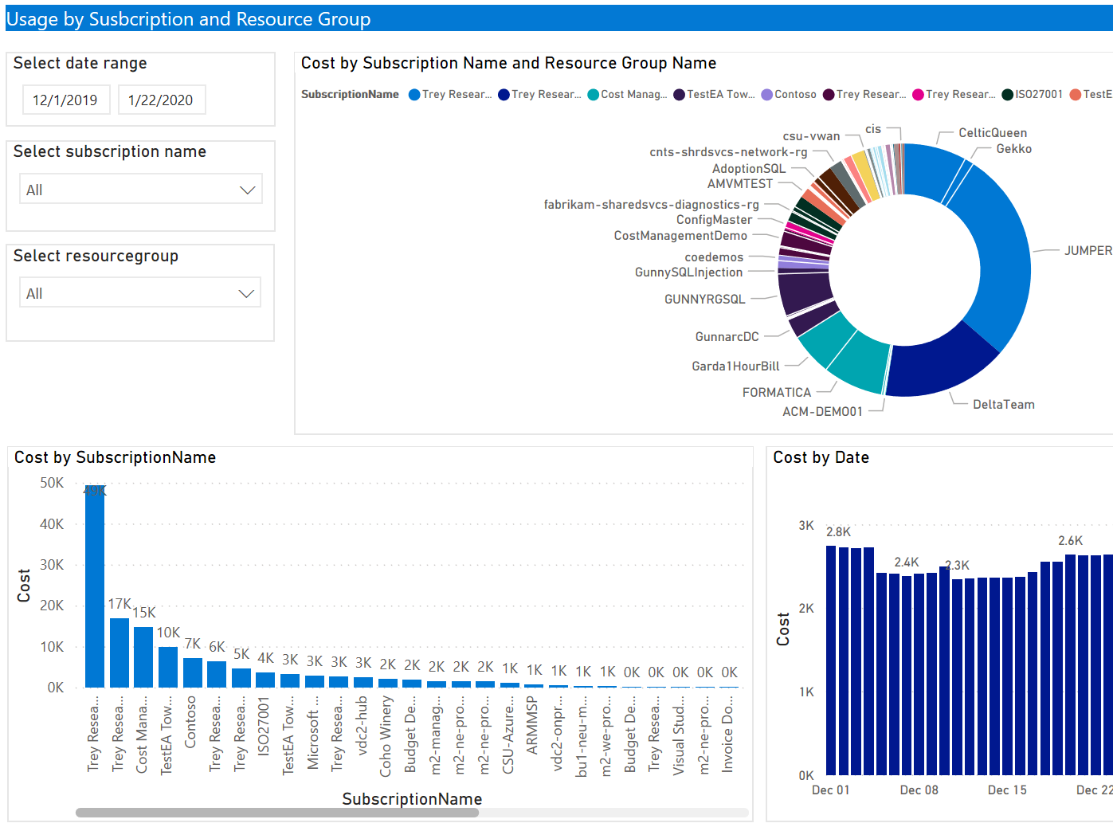
Azure Cost Management + Billing Power BI App
https://aka.ms/costmgmt/acmapp
Reports included:
Account overview
Usage by Subscriptions and Resource Groups
Top 5 Usage drivers
Usage by Services
Windows Server AHB Usage
VM RI Coverage (shared recommendation)
VM RI Coverage (single recommendation)
RI Savings
RI Chargeback
RI purchases
Pricesheet
EA admin: run the ACM Power BI Template App and share the results with the Microsoft team
Notes:
Available from AppSource
Built from the ACM Power BI desktop connector

Slide 14
DEMO:
Azure Pricing Calculator -> Estimate costs
Azure Cost management -> Azure portal
Azure Advisor -> Cost -> quick fix -> IP
Performance -> AKS recommended version
Advisor score –> reliability score index
Advisor REST API
Azure CM – PBI report -> aka.ms/costmgmt/acmapp
Azure compute Decision tree
Azure policy
Azure VM pricing across regions? https://azureprice.net/Region
Notes:
ACM Power BI App Template Power BI -aka.ms/costmgmt/acmapp

Slide 15
Operational Excellence
DevOps
CI/CD
Deployment
Monitor
Processes and cadence
Notes:
2. Moving just your resources to the cloud is taking advantage of only a small portion of what the cloud can bring to your organization.
Along with the technical capabilities, you can improve your operational capabilities as well.
From improving developer agility to improving your visibility into the health and performance of your application, one can improve the operational capabilities.
design principles for operation:
1) Perform ops as code
2) Make frequent, small, reversible changes
3) Anticipate failure
4) Refine opx procedure frequently
5) Learn from all opx failures

Slide 16
Performance Efficiency
Design for scaling
Optimize Network performance (CDN, ER, DNS Loadbalancer)
Optimize Storage performance (SSD, caching layer)
Monitor performance
Recommend - Azure monitor and Azure App insights
Notes:
3. Imagine that a news story was just published about one of your organization's recent product announcements.
The additional publicity from the news story will undoubtedly bring a large influx of traffic to your website.
Will your website be able to handle this traffic increase, or going to slow or unresponsive?
Under this pillar, we can check the basic principles of ensuring application performance by using scaling and optimization principles.

Slide 17
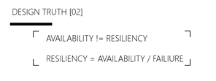
Reliability
Define requirements (HA requirements)
Test with simulations and forced failovers (Drills)
Deploy consistently
Monitor health
Respond to failure and disaster (DR and recovery plan)
Notes:
4. Imagine that you run a clinical system for a healthcare organization. Clinicians and caregivers have little tolerance for downtime. They need to have access to clinical IT systems around the clock.
To meet the around-the-clock demands of clinicians, applications must be able to handle failures with minimal impact to their users. How do they keep their applications operational, both for localized incidents and for large-scale disasters?
Imagine you're responsible for a system that must be always fully operational. Failures can and will happen, so how do you ensure that your system can remain online when something goes wrong? How do you perform maintenance without service interruption?
High availability (HA) ensures your architecture can handle failures.
There are three steps to evaluate an application for high availability:
Determine the service-level agreement of your application
Evaluate the HA capabilities of the application - Focus on single points of failure and critical components
Evaluate the HA capabilities of dependent applications
-------------------------
Availability sets
Availability zones
Load balancing
Platform as a service (PaaS) HA capabilities
===
DR: Disaster recovery is about recovering from high-impact events that result in downtime and data loss
Do you have DR plan? What is your RPO? RTO?
The maximum duration of acceptable data loss. RPO is measured in units of time, not volume: "30 minutes of data", "four hours of data", and so on.
RPO:
The maximum duration of acceptable downtime, where "downtime" needs to be defined by your specification. For example, if the acceptable downtime duration is eight hours in the event of a disaster, then your RTO is eight hours.

Slide 18
Reliability
Recommended services in Azure:
Azure Site Recovery
Azure Backup
HA, DR and backups
Azure TM, APG, ALB and PaaS inbuilt HA
Azure Back up for VM’s
Backup and restore capabilities for PaaS services
Recommended Patterns
Smart Retry -> Retry
Cascading failure avoidance -> Circuit breaker
Throttling -> APIM
Queue messaging -> Queue load leveling
Notes:
Handle transient failures , Continue operation during failure , Maintain consistent state, Data persistence and state
===============
Essential cloud architectures styles (Handle transient failures)
a) could be due to surges in demand which cause failure b) spikes traffic and load c) Load spike amid component failure
==============================
Smart retry -> RETRY Pattern
Cascading failure avoidance -> Circuit breaker and Throttling (APIM easy way)
Queue messaging -> queue load leveling
==================================
Combine these patterns

Slide 19
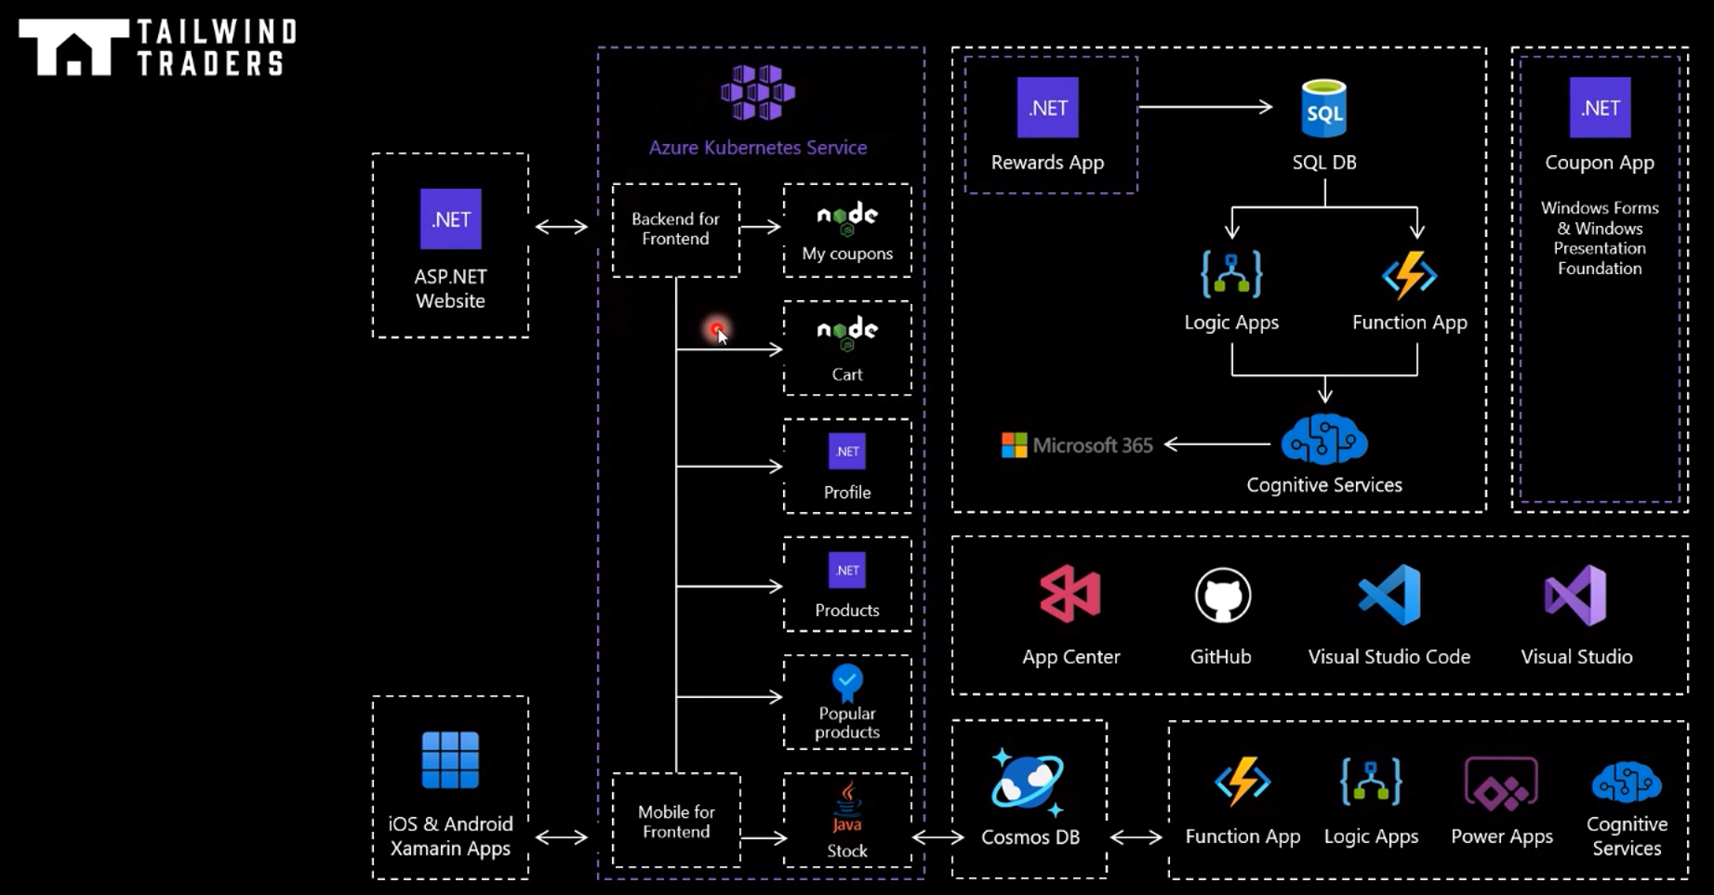

Notes:
What is the SLA
Design for failure
Failure mode analysis
--
What would you change in this workload to better meet the business requirements?

Slide 20
Azure Front door - Demo

Slide 21
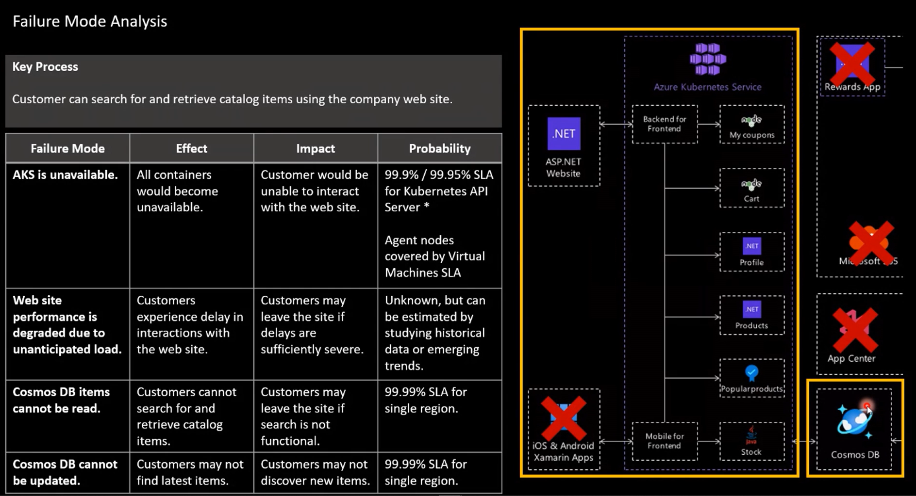
Notes:
Pricing calculator – AKS – SLA for API Server
Composite SLA
---
AKS – 2 cluster in two region (Multiple region)
IaaS code
Data later -> multi master db (multi write)

Slide 22
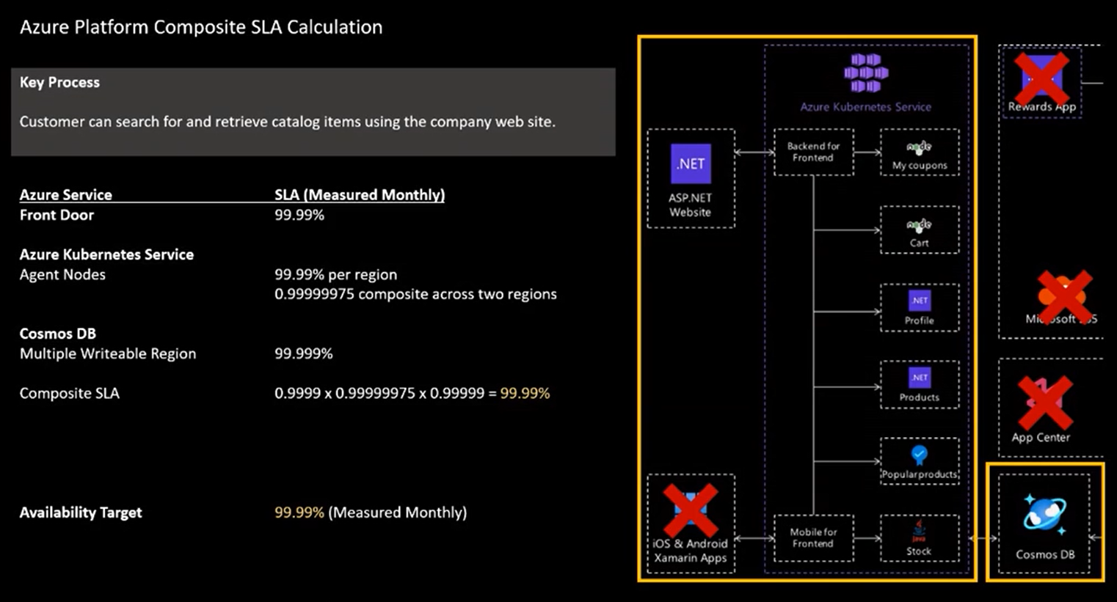
Notes:
Front door - demo

Slide 23
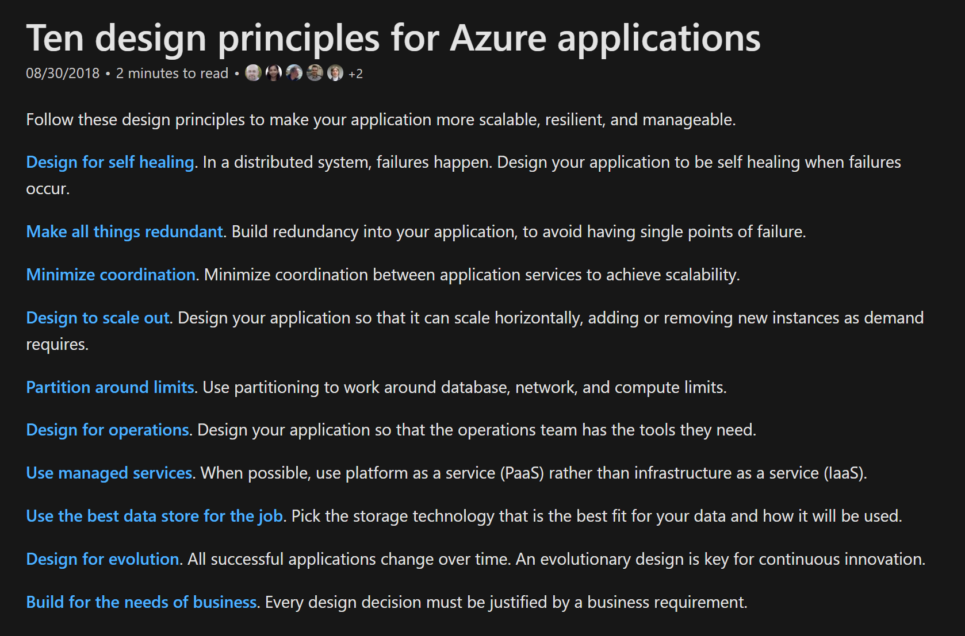
https://docs.microsoft.com/en-us/azure/architecture/guide/design-principles/

Slide 24
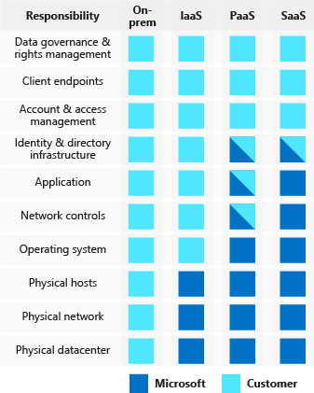
Security
Zero Trust model
Identity and access management - SSO, MFA
Infra protection – RBAC, PIM, SP, Managed Identities
App security
Data encryption and sovereignty
Network Security
Application Security
Notes:
Gone are the days when security focused solely on a strong perimeter defense to keep out hackers. Anything outside the perimeter was treated as hostile, whereas inside the wall, an organization's systems were trusted. Today's security posture is to assume breach and use the Zero Trust model.
Security professionals no longer focus on perimeter defense. Modern organizations have to support access to data and services evenly from both inside and outside the corporate firewall.
There's no easy solution that solves all your problems from a security perspective. Let's imagine you work for an organization that has neglected security in its environment. The company has realized that it needs to put some major focus in this area. The company isn't sure where to start, or if it's possible to just buy a solution to make the environment secure. The company knows it needs a holistic approach but is unsure what fits into that.
Here, we'll identify key concepts of defense in depth and identify key security tech nd approaches to support a defense-in-depth strategy. We'll also review how to apply these concepts when we’re architecting for security.

Slide 25
Azure Advisor – Security - Demo
Notes:
<Key point>: There are certain inhibitors to overall workload quality that we can resolve and overcome.
<Transition>: What are some common inhibitors affecting workload quality?

Slide 26
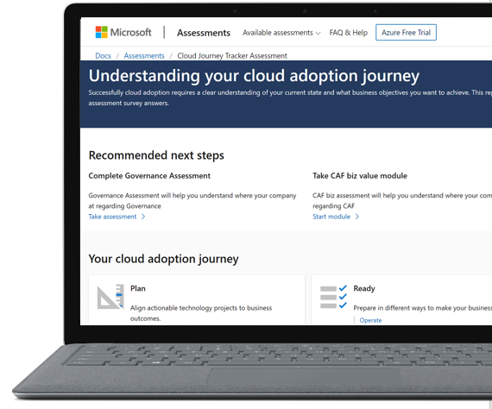
Assessment - Demo
Microsoft Azure
Well-Architected Review
https://aka.ms/architecture/review
Notes:
Examine your workloads through the lenses of reliability, cost optimization, performance efficiency, security and ops excellence.

Slide 27
Best practices to drive workload quality
Cost Optimization | Operational Excellence | Performance Efficiency | Reliability | Security
Azure Hybrid Benefit Reserve Instances Shutdown Resize Move to PAAS | DevOps Deployment Monitor Processes and cadence | Design for scaling Monitor performance | Define requirements Test with simulations and forced failovers Deploy consistently Monitor health Respond to failure and disaster | Identity and access management Infra protection App security Data encryption and sovereignty Security operations
https://aka.ms/architecture/framework

Slide 28
Overcoming workload quality inhibitors
Notes:
<Key point>: There are certain inhibitors to overall workload quality that we can resolve and overcome.
<Transition>: What are some common inhibitors affecting workload quality?

Slide 29
Overcoming workload quality inhibitors
Cost Optimization | Operational Excellence | Performance Efficiency | Reliability | Security
No cost and usage monitoring Unclear on underused or orphaned resources Lack of structure billing management Budget reductions due to lack of support for cloud adoption by LT/board | Lack of rapid issue identification No deployment automation Absence of communication mechanisms and dashboards Unclear expectations and business outcomes No visibility on root cause for events | No monitoring new services No monitoring current workloads health No design for scaling Lack of rigor and guidance for technology and architecture selection | Unclear on resiliency features/capabilities for better architecture design Lack of data back up practices No monitoring current workloads health No resiliency testing No support for disaster recovery | No access control mechanism (authentication) No security thread detection mechanism Lack of security thread response plan No encryption process
https://aka.ms/architecture/framework
Notes:
Sample list… many more

Slide 30
Summary
● Why is being well-architected important?
● Overview: Microsoft Azure Well-Architected Framework
● WAF Pillars, Demo, tools, reports
● Overcoming workload quality inhibitors
● WAF Assessment review, recommendations
● Resources

Slide 31

Where to start?
Take assessment
Microsoft Azure Well-Architected Review
Read Documentation
Well-Architected Framework
Complete Training
Well-Architected Learn module
Review Design Principles
Well-Architected design patterns
aka.ms/TheReview
aka.ms/TheFramework
aka.ms/AzureAdvisor
aka.ms/architecture/learn
aka.ms/architecture/framework
Browse Reference Architectures
Azure Architectures
Channel 9 WAF Episodes: (Nov-10-2020 * NEW CONTENT)
https://channel9.msdn.com/Tags/well-architected-series?WT.mc_id=azureenablement-ch9-cxa

Slide 32
Document or presentation title
Q&A
You can find this slide deck @MaheskBlr
https://twitter.com/MahesKBlr
Sponsored by

